Slide 1
Report 2
Parking Guidance System Solution

Slide 2
Table of Contents
Problem Definition
Project organization
Project Management Plan
Coding Convention

Slide 3

Problem Definition
Project name: Parking Guidance System Solution
Vietnamese name: Giải pháp hệ thống chỉ dẫn đỗ xe
Abbreviation: PGSS
Product Type: Internet of Things Application
Start Date: 3-Jan-2017

Slide 4
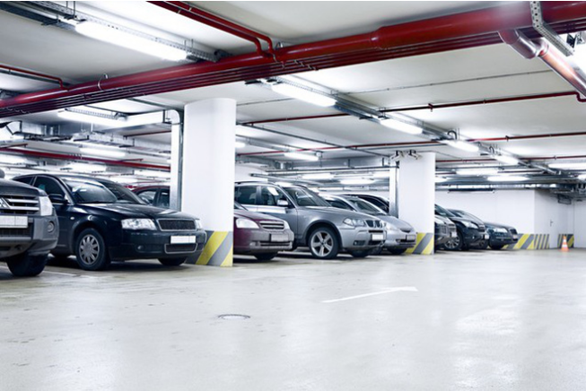
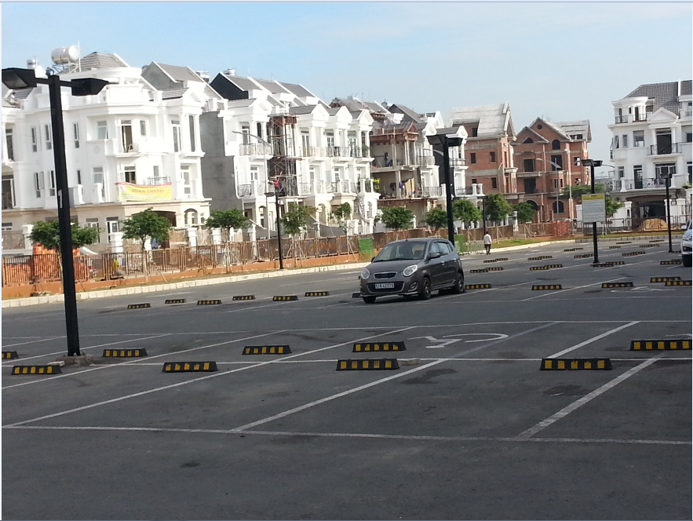
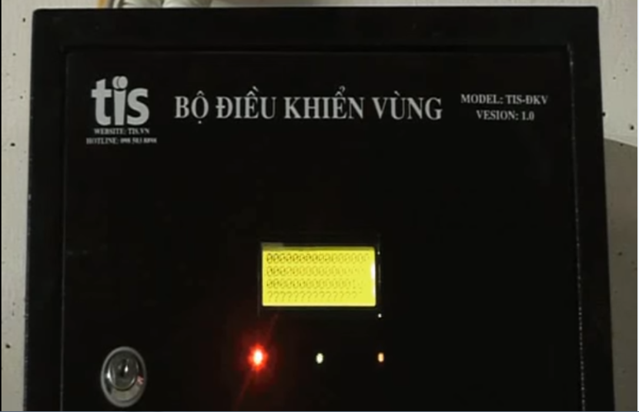
Current Situation
Indoor parking area
Outdoor parking area
Traditional PGS
Growing fast with the increasing number of vehicles
An alternative approach to provide vehicle’s parking lot
A wired system utilize the RS-485 standard.

Slide 5
Feature Functions
A Mobile Application
Detector using Ultrasonic Sensor
Information LED Displays for Main entrance and internal junction
Reservation Barrier
Indicator LED with RGB

Slide 6
Figure 1: Boundaries of the system

Slide 7
Development Environment
Hardware requirements
For Web API Server
For CCU
Components | Requirement
DTU | 10 DTU
Storage | 250GB
Components | Hardware
Mainboard | Raspberry Pi 3
Communication | USB Cable
Sensor Devices | Ultrasonic Sensor
Motors | Servo
Power Source
Table 2: Database requirement
Components | Requirement
Num of cores | 1 core
RAM | 1.75GB Ram
Storage | 10GB
Table 3: API Service Requirement
Table 4: Provide CCU Hardware

Slide 8
Development Environment
Software requirements
Windows XP/7/8/10: operating system for developing and deploying.
SQL Server Express 2012: used to create and manage database for PGSS.
Visual Studio 2015: used to develop API.
Arduino IDE: used to develop Arduino program.
Proteus 8: used to drawing board with other hardware.
Github & SourceTree: used for source control.
StarUML: used to create models and diagrams.
Slack: used for communication and meeting.

Slide 9
Project Organization

Slide 10
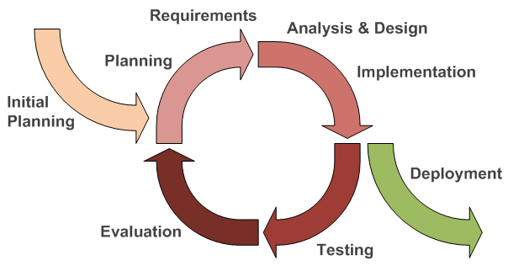
Software Process Model
Figure 2: Iterative and Incremental development

Slide 11
Roles and responsibilities
No | Full name | Team Role | Responsibilities
1 | Nguyễn Đức Lợi | Supervisor, Project Manager | Specify user requirement Advisor for ideas and solutions Control the development process Give out techniques and business analysis support
2 | Trần Nguyễn Minh Trung | Team Leader, BA, Developer, Tester | Managing process Managing budget Dividing tasks for team member Create test plan Clarifying requirements Prepare document Coding Testing
3 | Bùi Phú Hiệp | Team Member, Developer, Tester | Create test plan Clarifying requirements Prepare document Coding Testing
4 | Nguyễn Đỗ Phương Huy | Team Member, Developer, Tester | Create test plan Clarifying requirements Prepare document Coding Testing

Slide 12
Tools and Techniques
Tools
Operating System | Windows 7 Ultimate
 | Raspbian Jessie
Developing tool | Android Studio
 | Visual Studio 2015 Community
 | IDLE 3
 | Arduino IDE 1.6.12
Managing Database | SQL Server 2014 Management Studio
Source Control | Git 2.8.1 (Server https://github.com)
 | SourceTree 1.9.10
Communication tool | Gmail
 | Slack
 | Trello
Models and Diagrams tool | https://www.draw.io/, StarUML
Techniques
Embedded System | C/C++
 | Arduino
 | Python 3
Mobile System | Android SDK
 | Retrofit 2
 | Google Map
Web Server System | Azure Cloud
 | ASP.NET

Slide 13
Project Management Plan

Slide 14
System development life cycle
Phase | Description | Deliverables | Risks
Inception | In this phase, we will identify project scope, requirements (functional and non-functional) and risks at a high level but in enough detail that work can be estimated | Introduction of proposed system Software and Hardware requirement specification Project Task Plan and Risk | The lack of knowledge may lead to misunderstand of the requirement The inexperienced of team may lead to deficient in Task Plan and Risk
Elaboration | Delivers a working architecture that mitigates the top risks and fulfills the non-functional requirements | Software and Hardware design document | System architecture or design issues may arise because not all requirements are gathered
Construction | Incrementally fills-in the architecture with production-ready code produced from analysis, design, implementation, and testing of the functional requirements | Completed and fully tested system Implementation and Test document | The lack of knowledge of team member about hardware The inexperienced of team may lead to missing test cases There may be hidden High to Critical bugs in the system
Transition | Delivers the system into the production operating environment | User manual document Installation guide document The final and full version document of the system | The documents may not fully describe the system
Table 8: System Development Life Cycle

Slide 15
Plan Detail
Iteration | Scope | Evaluation | Activities | Estimated Duration | Assign Responsibilities
Initial Iteration | Initial team workplace and identify project scope | A working team environment | Set up Git Repository with Gitflow Set up Slack Set up Trello | 5 days | TrungTNM, HiepBP, HuyNĐP
Iteration 1 | Identify boundaries of the system, planning software and hardware. Create a proof-of-concept prototype. | Report 1, Report 2 and a proof-of-concept prototype | Introduction document Software and Hardware Project Management Plan document Proof-of-concept prototype | 15 days | TrungTNM, HiepBP, HuyNĐP
Iteration 2 | Produce an architectural prototype | Report 3, Report 4 and an architectural prototype | Software and Hardware Requirement Specification document Software and Hardware Design Description document Architectural prototype | 15 days | TrungTNM, HiepBP, HuyNĐP
Iteration 3 | Build the product (up to beta release) | Report 5 and a working product (beta release) | System Implementation and Test document PCB Mobile Application Web API Server | 15 days | TrungTNM, HiepBP, HuyNĐP
Iteration 4 | Finish the product (full product release) | Report 6 and the completed product | Software and Hardware User’s Manual document Product demonstration model | 15 days | TrungTNM, HiepBP, HuyNĐP
Final Iteration | Prepare for Demo Day | Final Documentation, Presentation Slide | Final Document Mini Document CD contains all source code Presentation Slide | 5 days | TrungTNM, HiepBP, HuyNĐP
Table 9: System Development Detail Plan

Slide 16
Coding Convention

Slide 17
C/C++
Using to develop program and solve algorithm on hardware.
Summary:
Naming Convention:
Using Pascal case for class name.
Using Camel case for function, variable’s name.
The #define and global variable’s name must uppercase and separate by underscore. Ex: GLOBAL_VARIABLE.
Commenting Convention:
Place the comment on the separate line with function.
Place the comment at the end of the line, which has calculation formula.
More details abount code conventons for C/C++ language by Google:
https://google-styleguide.googlecode.com/svn/trunk/cppguide.html

Slide 18
C#, ASP.NET
Using to develop Web API
Summary:
Naming Convention:
Use Camel case for variable’s name.
Use Pascal case for class’s name, function’s name.
Global variable’s name must uppercase and separate by underscore.
More detail about code conventions for C# language by Microsoft:
https://msdn.microsoft.com/en-us/library/ff926074.aspx

Slide 19
Python
Using to develop program on Raspberry Pi
Summary:
Naming Convention:
"Internal" means internal to a module or protected or private within a class.
Place related classes and top-level functions together in a module. Unlike Java, there is no need to limit yourself to one class per module.
Use Pascal Case for class names, but lower_with_under.py for module names.
More detail about code conventions for Python by Google:
https://google.github.io/styleguide/pyguide.html

Slide 20
Android
Android use Java and HTML to develop mobile application
Summary:
Naming convention:
Follow basic principle of <WHAT>_<WHERE>_<DESCRIPTION>_<SIZE> for resource names
Follow basic principle of <WHAT>_<WHERE>.XML for layout
Follow basic principle of <WHERE>_<DESCRIPTION> for string resources
Follow basic principle of <WHERE>_<DESCRIPTION>_<SIZE> for drawable resource
Follow basic principle of <WHAT>_<WHERE>_<DESCRIPTION> for IDs
More detail about code conventions for Android by Google and our team:
https://source.android.com/source/code-style.html
https://github.com/Hinaka/-FPT-CAPSTONE-PGSS/tree/master/Common

